Slide 1
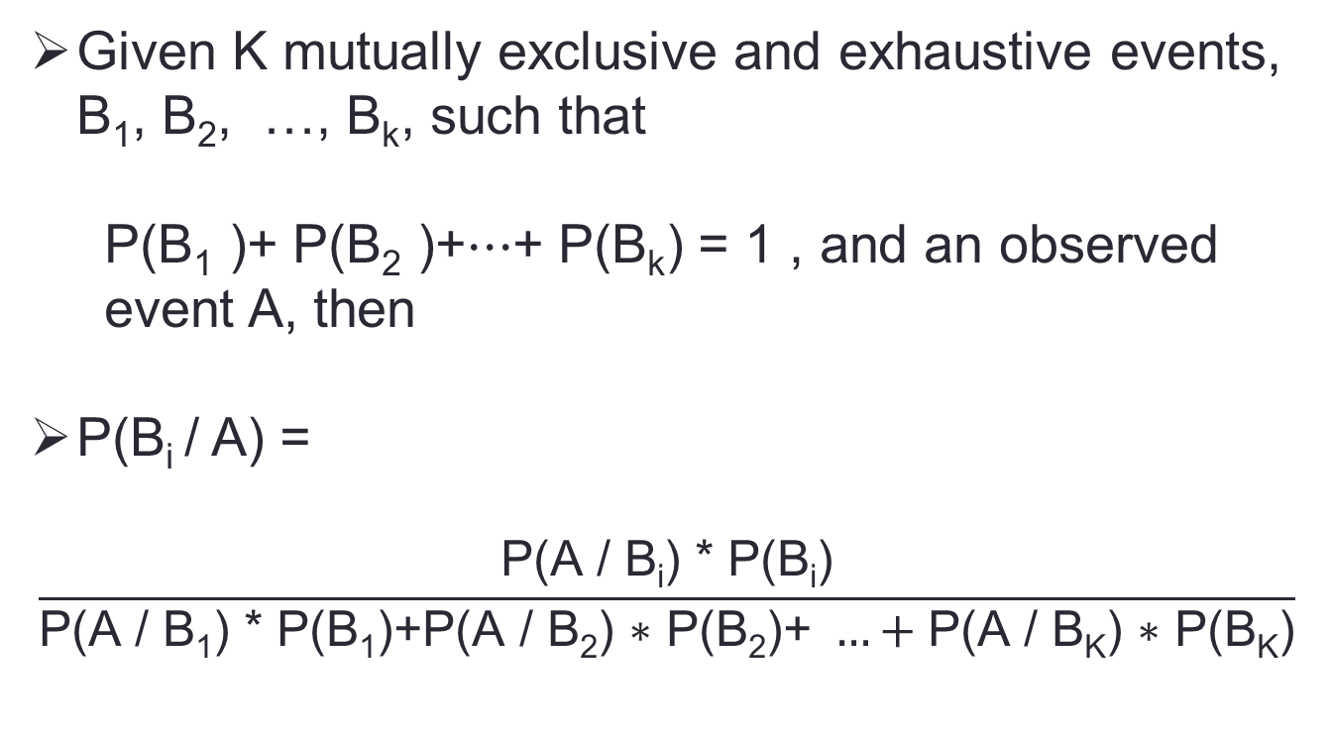
Bayes’ Rule
Given K mutually exclusive and exhaustive events, B₁, B₂, …, B_{k}, such that
P(B₁ )+ P(B₂ )+⋯+ P(B_{k}) = 1 , and an observed event A, then
P(B_{i} / A) =
$$\frac{\text{P}\text{(}\text{A}\text{ / }\text{Bi}\text{) ∗ }\text{P}\text{(}\text{Bi}\text{)}}{\text{P}\text{(}\text{A}\text{ / }\text{B}\text{1}\text{) ∗ }\text{P}\text{(}\text{B}\text{1}\text{)}\text{+}\text{P}\text{(}\text{A}\text{ / }\text{B}\text{2}\text{) ∗ }\text{P}\text{(}\text{B}\text{2}\text{)}\text{+ }…+\text{P}\text{(}\text{A}\text{ / }\text{BK}\text{) ∗ }\text{P}\text{(}\text{BK}\text{)}}$$

Slide 2
Bayes’ Rule
A construction company employs three sales engineers. Engineers 1, 2, and 3 estimate the costs of 30%, 20%, and 50%, respectively, of all jobs bid by the company. For i = 1, 2, 3 define E_{i} to be the event that a job is estimated by engineer i. The following probabilities describe the rates at which the engineers make serious errors in estimating costs:
P(error/E₁) = 0.01, P(error/E₂) = 0.03, and P(error/E₃) = 0.02

Slide 3
Bayes’ Rule
P(E₁) = 0.3, P(E₂) = 0.2, and P(E₃) = 0.5
P(error/E₁) = 0.01, P(error/E₂) = 0.03, and P(error/E₃) = 0.02
P(E₁/error) = ?

Slide 4
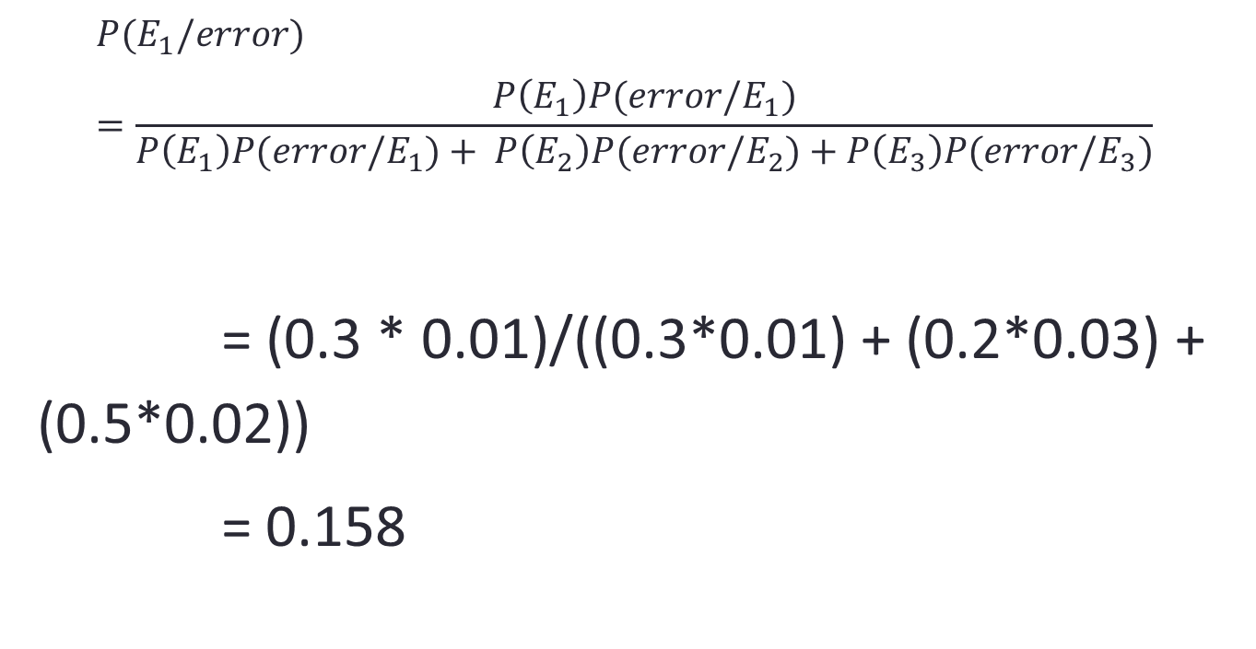
Bayes’ Rule
$$P(E_{1}/error)=\frac{P\left(E_{1}\right)P(error/E_{1})}{P\left(E_{1}\right)P(error/E_{1})+ P\left(E_{2}\right)P(error/E_{2})+P\left(E_{3}\right)P(error/E_{3})}$$
= (0.3 * 0.01)/((0.3*0.01) + (0.2*0.03) + (0.5*0.02))
= 0.158

